Slide 1
3D printing and amateur radio!
Some assembly required…

Slide 2
Who is this person?
My name is Michelle Thompson W5NYV.
I have a BSEET, BSCET, and a math minor from UALR. I have a MSEE (info theory) from USC.
I enjoy thinking and doing. Not necessarily in that order.
I work at Optimized Tomfoolery, an engineering partnership devoted to art, science, and engineering. My specialty is applied mathematics.
I've been a ham since 1994.
I have been 3D modeling and printing for five years.
Notes:
(Plenty book lernin')
(Hey ya'll. Watch this!)
My primary interest is in technical experimentation on the microwave bands. I lead AMSAT Phase 4 Ground, am trustee for Palomar Amateur Radio Club, and am a life member of 10-10 International, ARRL, and AMSAT.

Slide 3
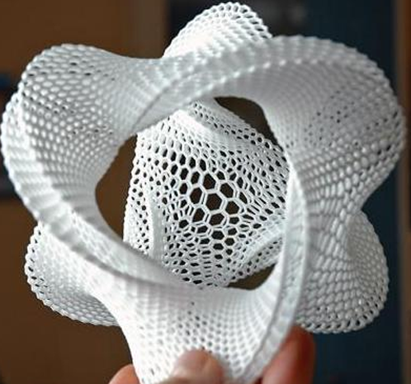
3D printing
A set of tools, technology, and techniques that takes a model, usually defined in software, and turns it into a physical object.
Objects are most often printed one at a time. This technology is most appropriate for prototyping or creating a unique object. 3D printing is not usually considered to be a mass production technology.
3D printing can be used to make objects that would be very difficult or impossible to make otherwise.

Slide 4
What is it good for?
Is it easy yet?
Notes:
Industrial 3D printers have been around for a while. At least since 1989. By far the most common use in industry is to accelerate product development, followed closely by customized products and to provide production flexibility.
Hobbyist and experimenter 3D printing options are relatively recent. By late 2015, there were 257 companies in 9 categories across 27 countries, with a total of 517 million in funding.
New startups are at every Maker Faire, and places like San Diego MakerPlace have high-end 3D printers for members to use, right beside table saws and sewing machines.
"3D printing is not yet a commodity process for makers, experimentalists, and hobbyists." 3D printers are not like microwave ovens, where you put in the cup of cold water and you get a cup of hot water back out with six sigma certainty. 3D printers are not yet appliances, but that is clearly the goal of many 3D printer companies. Some of them simply try and sell their printers as if they were already there. When 3D printing is brought up in the educational space, and a school purchases a printer or gets one donated, and there isn't a human resource dedicated to keeping it running, adjusted, maintained and teaching all the different skill sets required to use it, then it inevitably ends up in a corner. Why? Because...

Slide 5
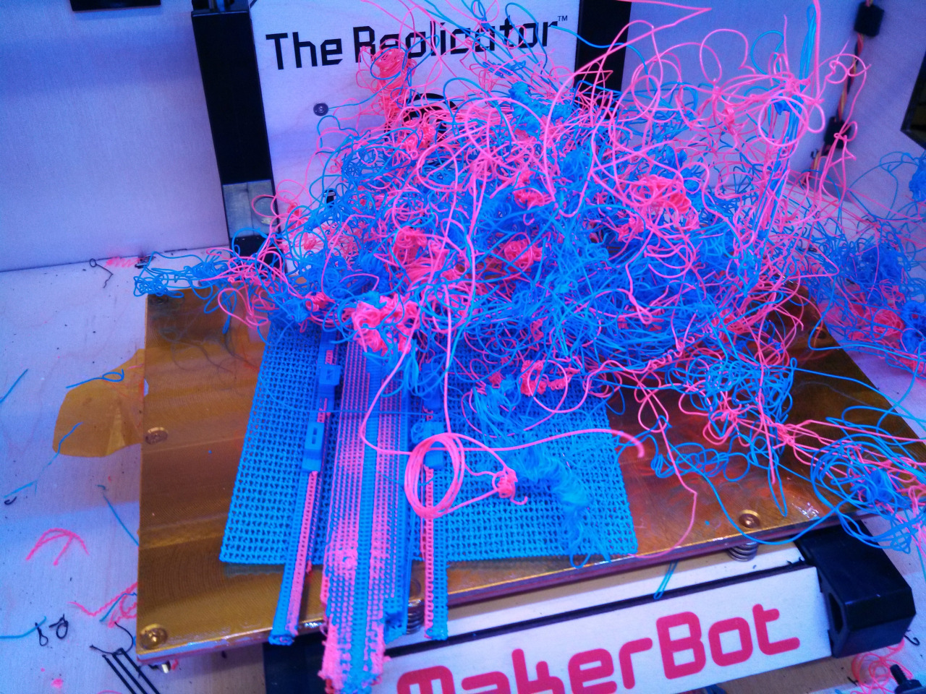
Notes:
Because there are a lot of degrees of freedom and skills involved. The first time you try to print something feels like trying to sit down at a sewing machine and make a wedding gown when you've never stitched on a button. With 3D printing, sometimes you nail it, and sometimes you accidentally sew over your own finger. This has happened to me. Both the witch's hair and the sewing needle thing.

Slide 6
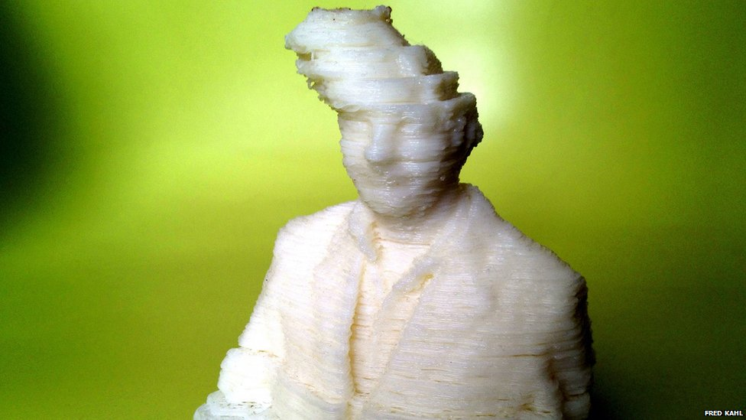
Notes:
This guy has been driven insane by 3D printing problems.
There are actually two things going on here. Layers didn't adhere due to temperature being too cool, and the stepper motor kept going and started a new layer off in midair. Both of these things have happened to me.

Slide 7
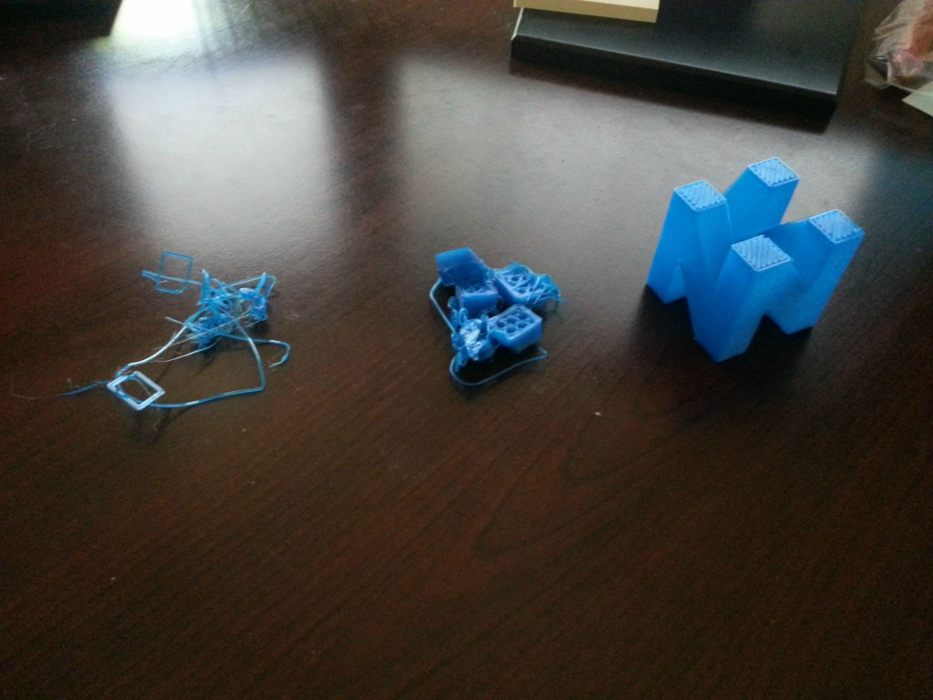
Notes:
Behind every successful print is two others that are probably in a landfill. (waste!) This is a progression of refining the settings and techniques. The object on the right is a successful print.

Slide 8
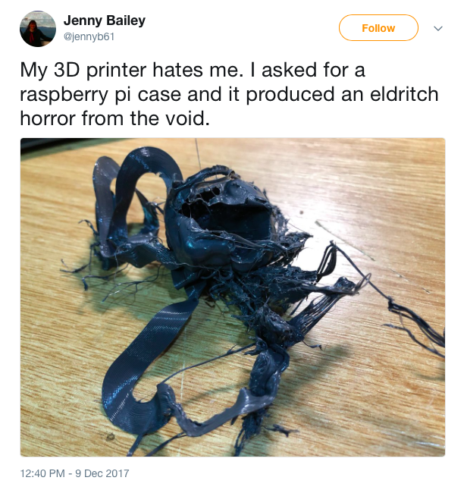
Notes:
From a couple days ago.

Slide 9
Problems encountered
The brand of glue stick matters.
Knurled bolt misalignments can drive you insane.
Tension on the filament must be Just Right.
Filament may tangle coming off the reel, jam, and drag the print head off target.
Temperature requirements can vary from reel to reel even within same make and model filament.
Components in the hot ends can wear out. Suddenly. Or not.
Thermistors can wear out. Suddenly. Or not.
Stepper motors can skip steps.
Control software doesn't let you pause a print (until recently).
Fans can fail unnoticed and cause unexpected behavior.
PLA is hydrophilic.
Bowden tubes can slip or gum up.
You can leave a tool where the stepper motor can eat it*

Slide 10
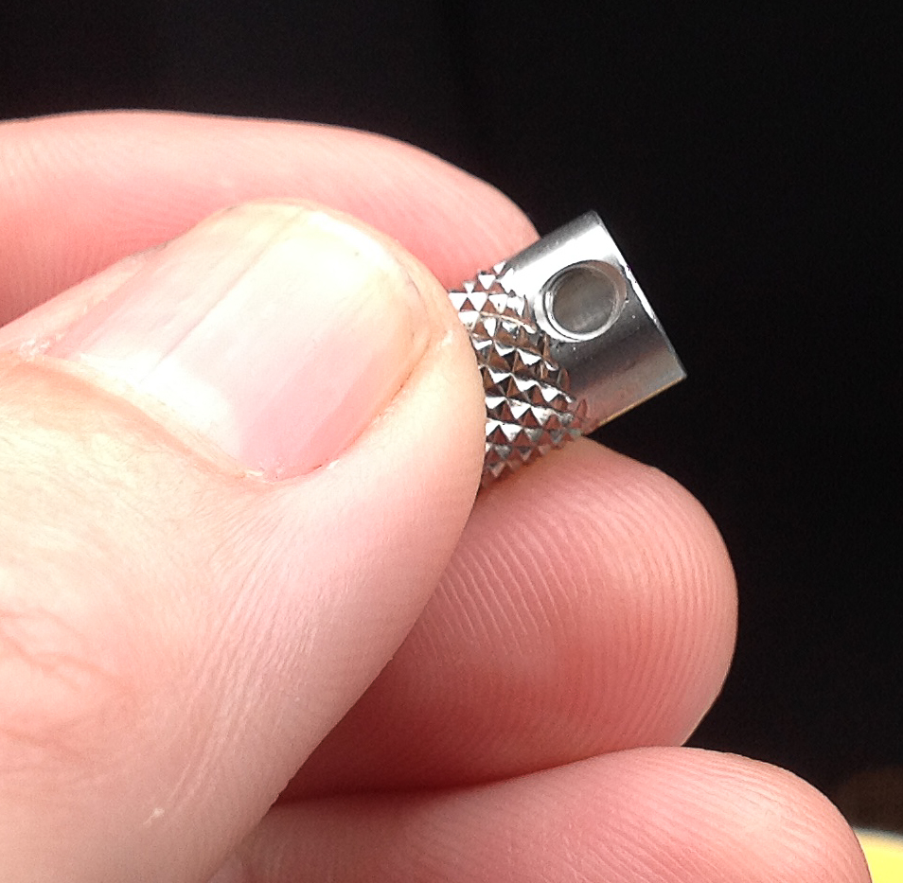

Slide 11
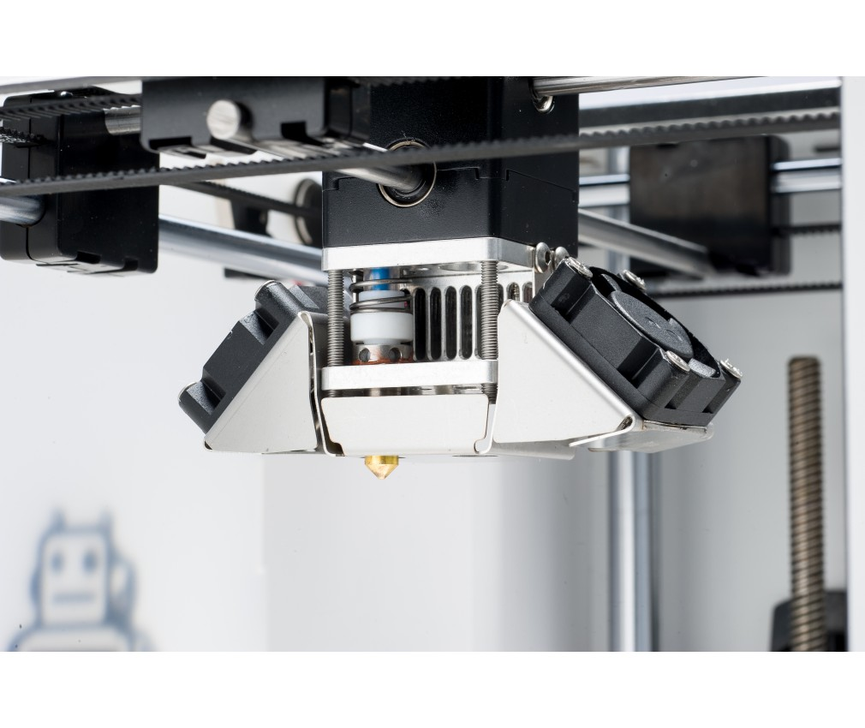

Slide 12
Despite the challenges,
3D printing is great!
Making things!
Repairing things!
Art!
Fashion!
Design!
Antenna prototyping!
Notes:
Making things is fundamental to being human. The maker movement gets a lot of press and attention. People are celebrated because they make an interesting, useful, or beautiful artifact. The more "from scratch" the object or artifact is, the better.
However, another extremely important area for 3D printers is in fixing things. If you've ever gotten into a hobby such as renovating old cars, or repairing old radios, then you have run into the problem of things turning into unobtanium. As long as you can describe or scan or specify a part, you can 3D print it. If you can 3D print it, then you can cast it, make a mold, and make that part out of something more durable than the materials of what you usually print with.
The artistic side of 3D printing is enormous. Jewelry, sculptures, clever puzzles, toys, clothing, shoes, you name it. It's becoming a big deal in fashion to incorporate 3D printed aspects. Sometimes this is out of hard plastic material, and sometimes out of softer material.
Finally, design. There is two aspects here. First, rapid prototyping where you do not send out your work to a third party. 3D printers allow you to keep your intellectual property within your company. With substantial industrial espionage going on, this is a big deal. Second, I can tell you all about this great new product. I can describe it, render it in 2D, go full marketing on you. However, if I can hand you a scale model of that thing, whether it is a car, a satellite, a building, furniture, anything really, then I have made it more real and you will be more inclined to believe I can produce it. Being able to rapidly create complex and highly detailed scale models of things from a design perspective is enormously powerful.

Slide 13
3d printing workflow
Come up with an idea that you want to print.
Create or obtain a 3D model.
Properly prepare the model for printing.
Convert the model into instructions that a 3D printer can understand.
Determine the settings required for that particular printed model
Print the model.

Slide 14
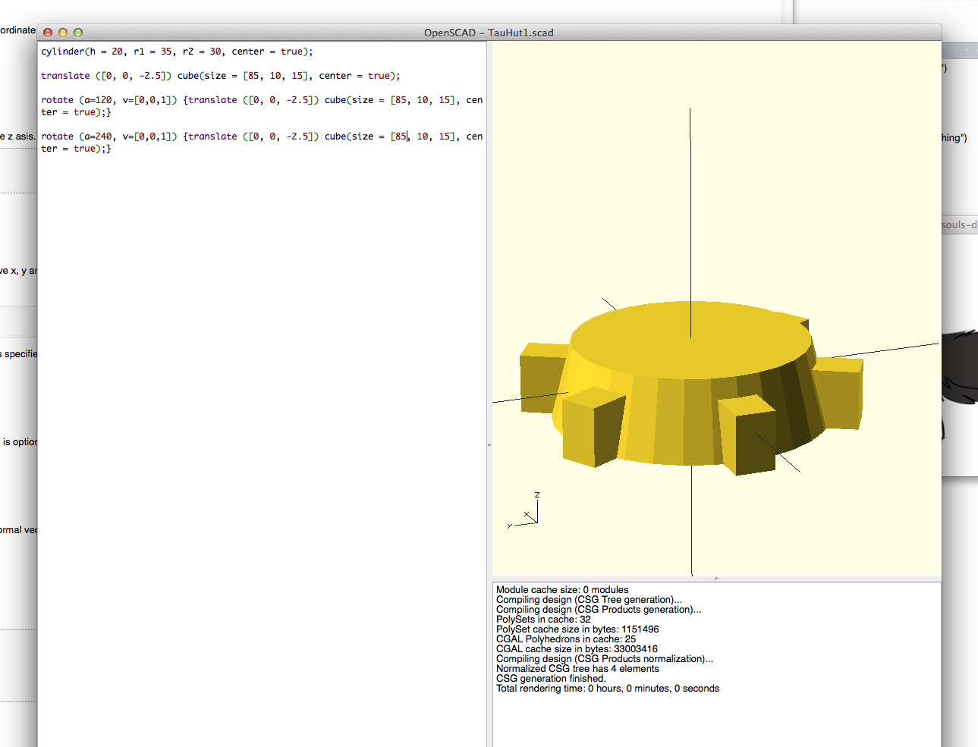

Slide 15
cylinder(h = 20, r1 = 35, r2 = 30, center = true);
translate ([0, 0, -2.5]) cube(size = [85, 10, 15], center = true);
rotate (a = 120, v = [0, 0,1])
{
translate ([0,0,-2.5]) cube(size = [85, 10, 15], center = true);
}
rotate (a = 240, v = [0, 0,1])
{
translate ([0,0,-2.5]) cube(size = [85, 10, 15], center = true);
}
Notes:
Detail of the commands used in OpenSCAD.

Slide 16
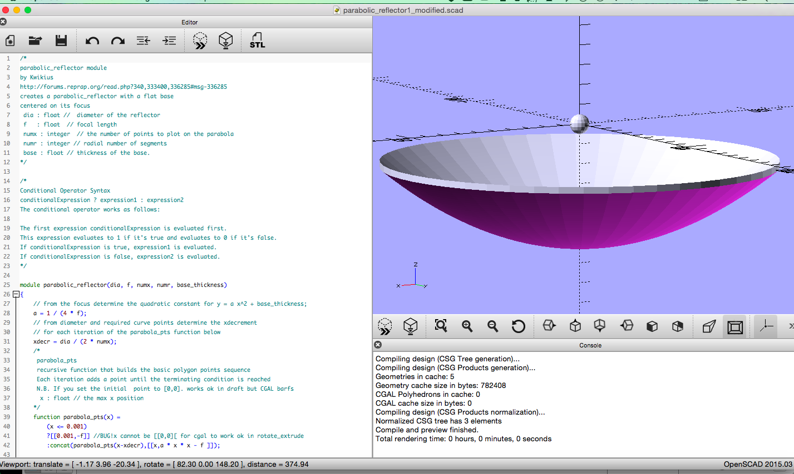
Notes:
Current project, a 122GHz dish, feed, and subreflector.

Slide 17
3d printed
10Ghz horn
Can we use 3d printing to prototype antennas?

Slide 18
Motivation: higher performance
Rectangular horn antennas have good performance and are easy to manufacture
Curved tapers (elliptical, exponential, etc.) offer higher or ideal performance but are not easy to manufacture.
3D printing allows almost any arbitrary shape to be printed.
If the shape can be specified, and the shape can be printed, and then the printed shape metallized, then experimentation with complex tapers becomes more accessible.
Challenge accepted!
Notes:
Why do we need complex horn shapes?

Slide 19
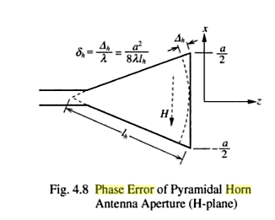
Notes:
Why do we need complex horn shapes? Phase error.

Slide 20
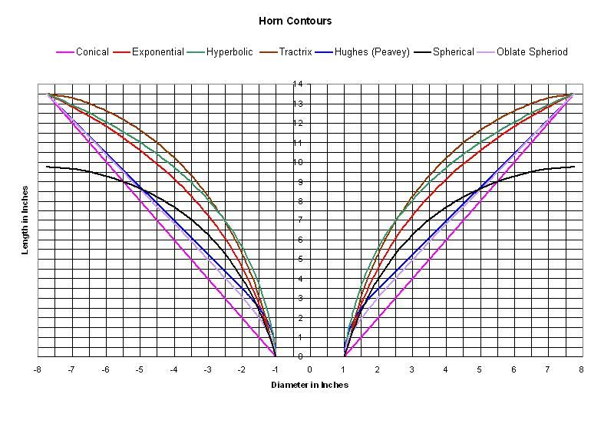
Notes:
Here's a comparison of horn contours, or tapers. Each taper affects the reflected wavefront differently.

Slide 21
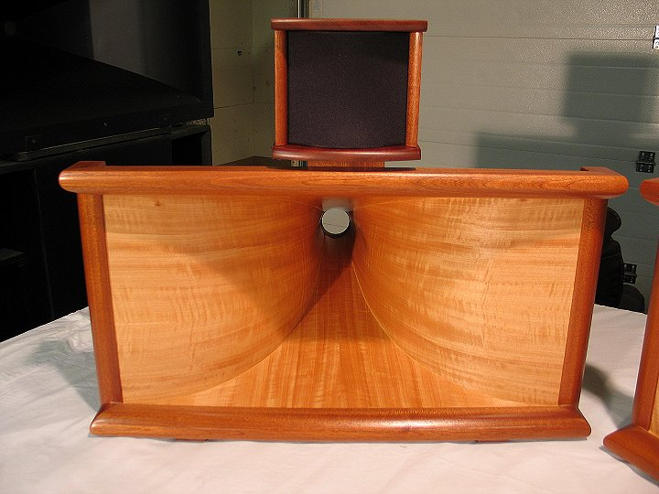
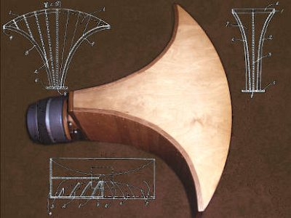
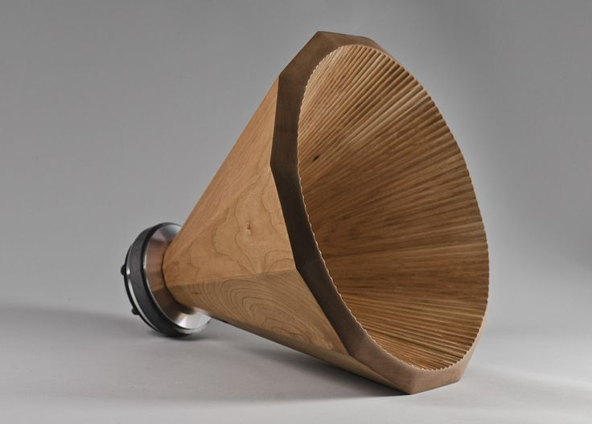
Notes:
The ability to amplify audio created a huge demand for research into improving horn antenna design.

Slide 22
Verification using existing design
Find a known-good horn antenna model
Print it!
Metallize it!
Test it!
Move on to designing a complex taper horn antenna...

Slide 23
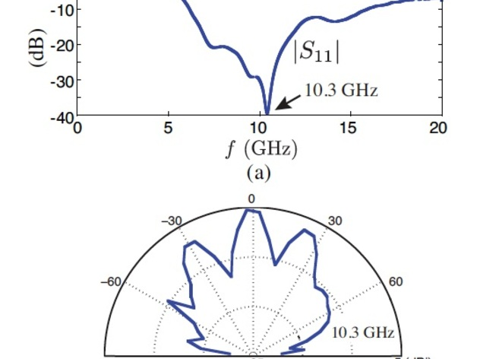
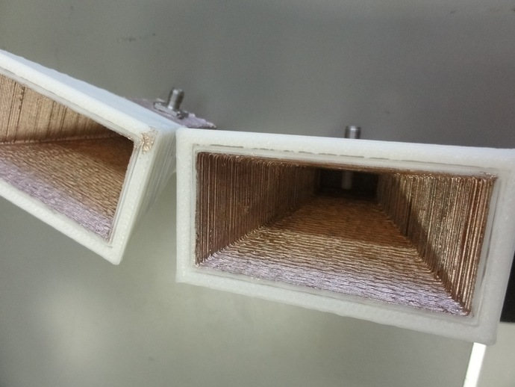

Slide 24
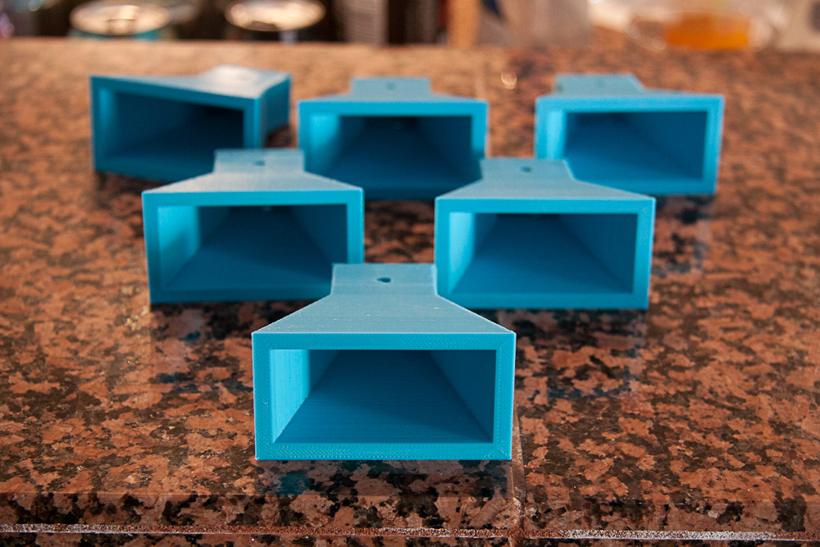
Notes:
Start with something that we *know* works in metal. Print it and then make it match to prove that 3d printed horns will work for research.

Slide 25
Elliptical taper 10GHz horn
Ellipses are basic geometric shapes. Instead of straight sides, just make the sides out of solid elliptical shells and stick it on a waveguide-shaped rectangular prism with an SMA hole. How hard can it be?
Notes:
214 lines of code, researching how to mathematically specify a horn antenna, and weeks of working through mistakes in the modeling resulted in almost exactly what was predicted. Whew!

Slide 26
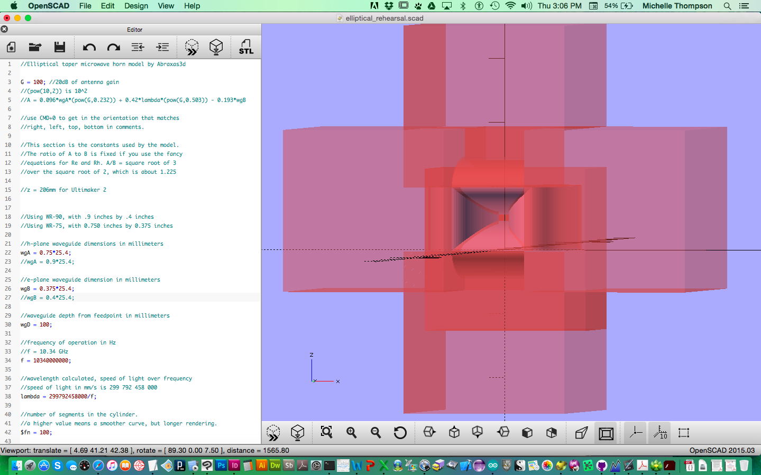

Slide 27
The scaling problem
Make a cylinder.
Make a slightly smaller cylinder.
Subtract the smaller cylinder from the larger cylinder to make a cylindrical shell.
Scale the shell in one axis but not the other to make an elliptical cylindrical shell.
Use rectangular prisms to subtract excess parts of the shell.
Voila! Elliptically-tapered side! Only three sides more to go...
Hey.
Why isn't the wall thickness constant all along the elliptical shell?
Does it matter?
Only the inner wall matters for reflectivity... so maybe not...
But it's bugging me.
A lot.
How to fix it?

Slide 28
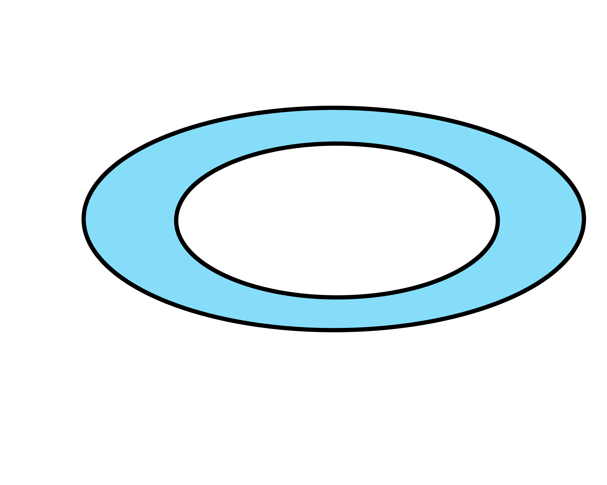
//factors to scale the ellipse for proper size
escale_inner = ((0.5*A - 0.5*wgA)/Lh);
hscale_inner = ((0.5*B - 0.5*wgB)/Lh);
escale_outer = ((0.5*A - 0.5*wgA - wall_thickness)/(Lh - wall_thickness));
hscale_outer = ((0.5*B - 0.5*wgB - wall_thickness)/(Lh - wall_thickness));

Slide 29
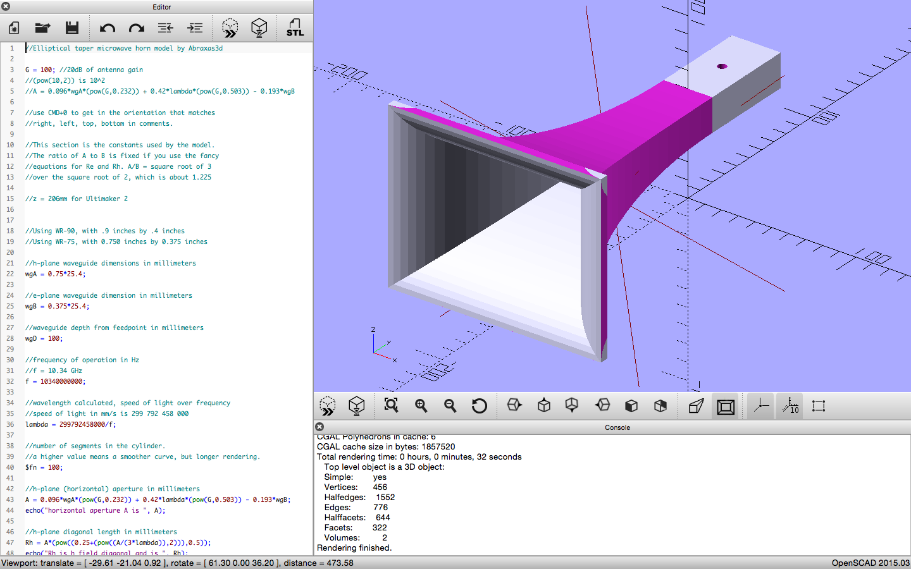

Slide 30
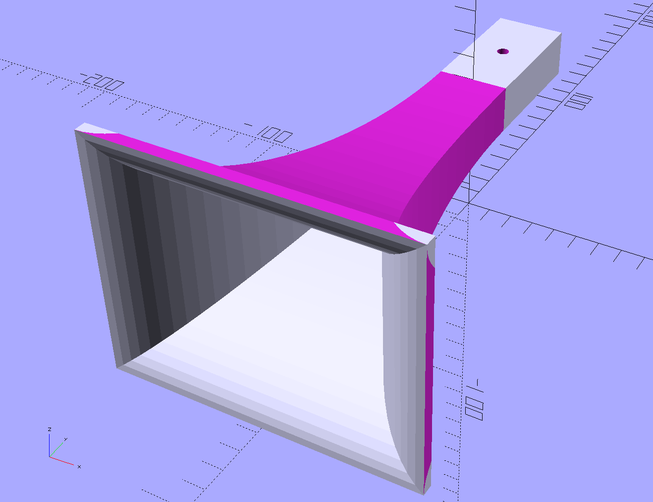

Slide 31
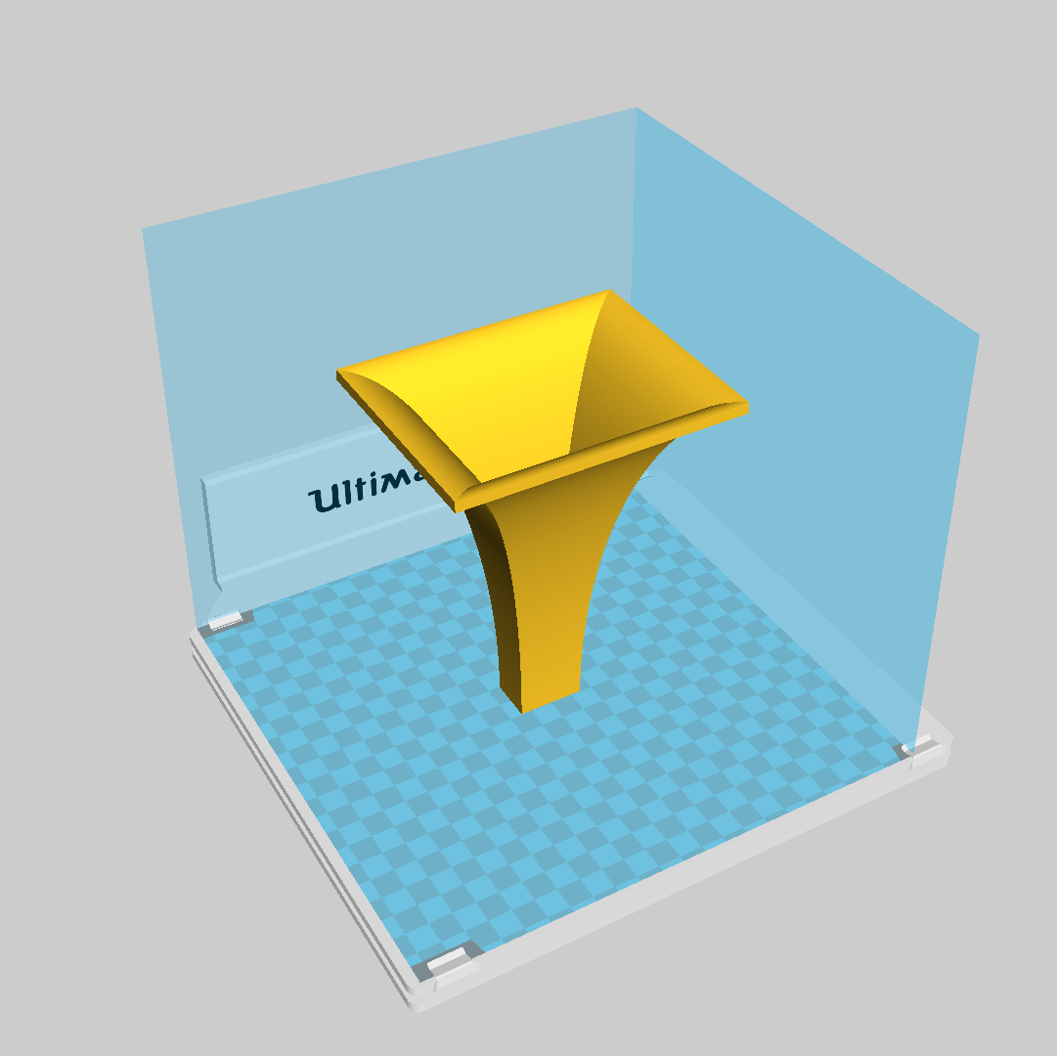
Model imported into slicer
After a 3D model is captured or specified in the 3D modeling software, the resulting shape is imported into another program that transforms the shape into instructions the printer can understand. Most 3D printers create "slices" of the model. Each slice is a printed layer. Therefore, these programs are sometimes referred to as "slicers".

Slide 32
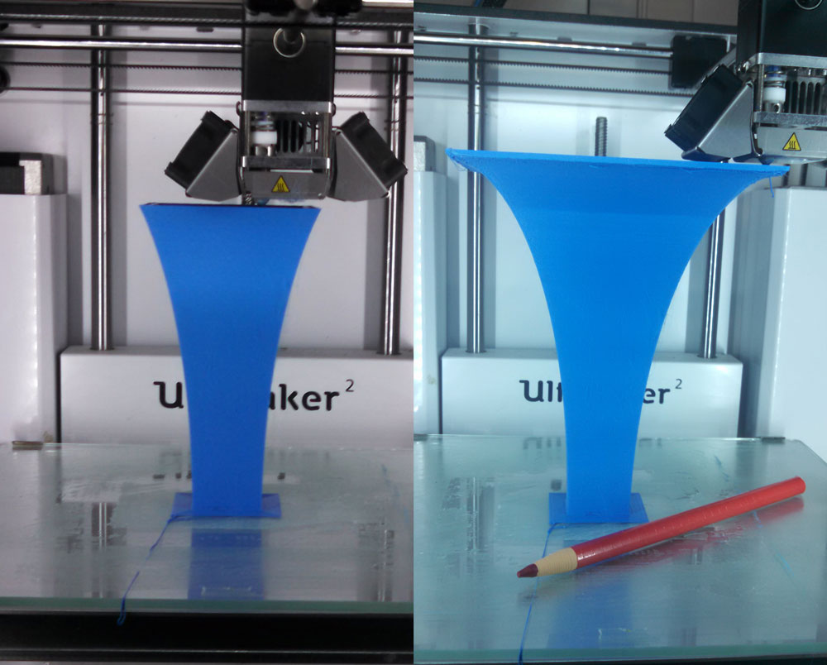
Notes:
Here is the print in action! 40 hours to print the horn.

Slide 33
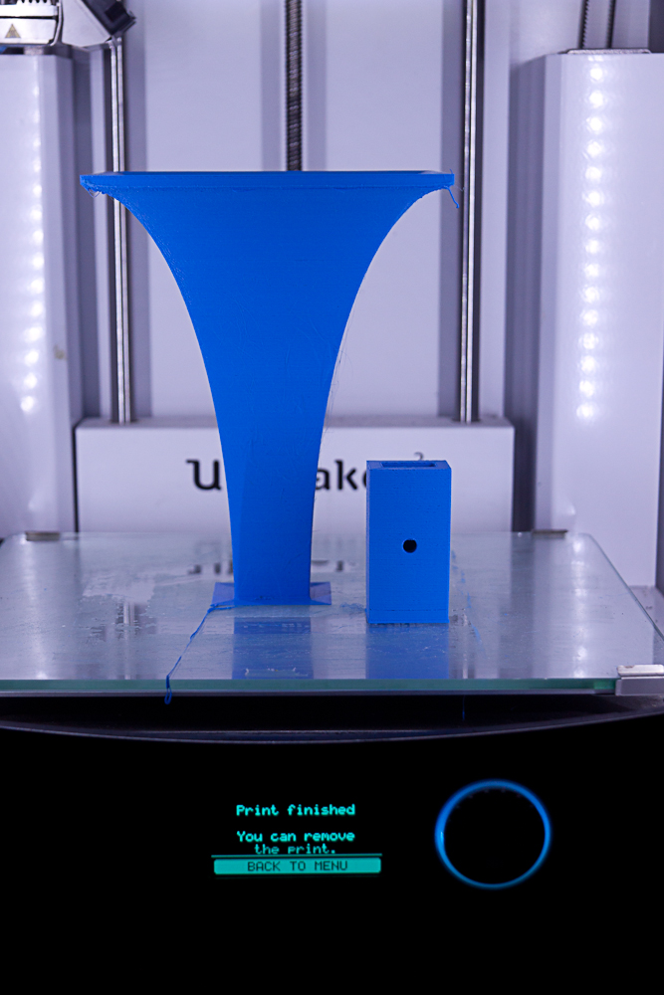

Slide 34
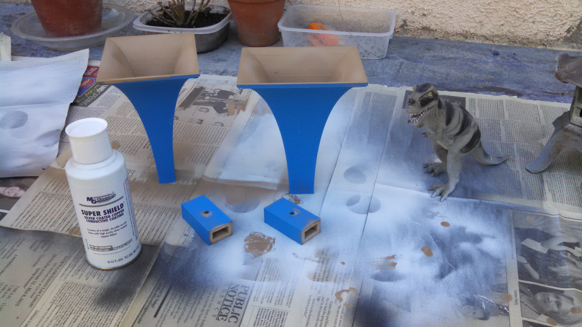
Notes:
Metallization. Dinosaur for scale.

Slide 35
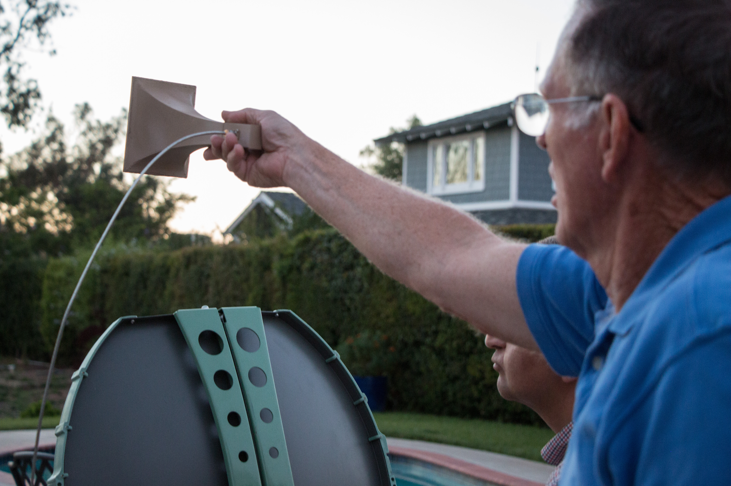
It worked*
Notes:
One of two elliptical horns worked. The failure was due to the way the two pieces were glued together. Another area of active research and improvement is the SMA connector. Moving to a waveguide-based horn is an obvious solution.

Slide 36
Fox1B 1:1 scale model
Can we use 3d printing to make a model for radio education?

Slide 37
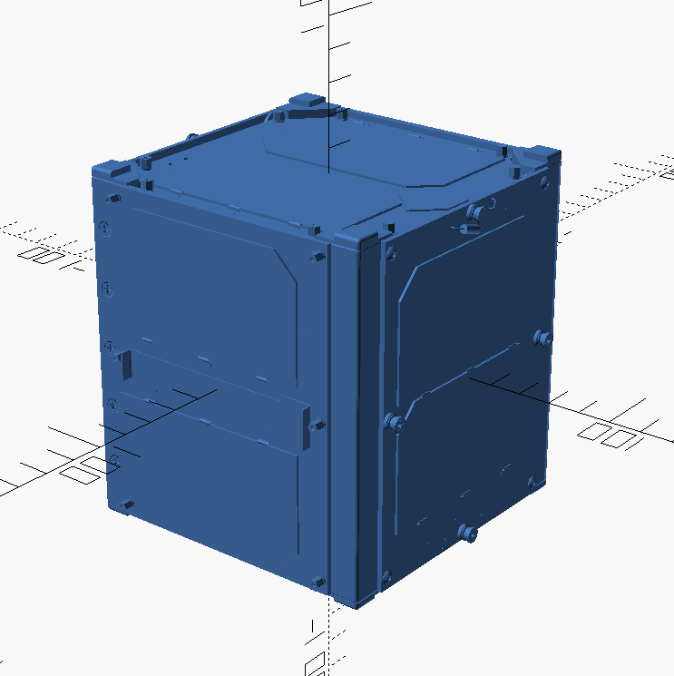
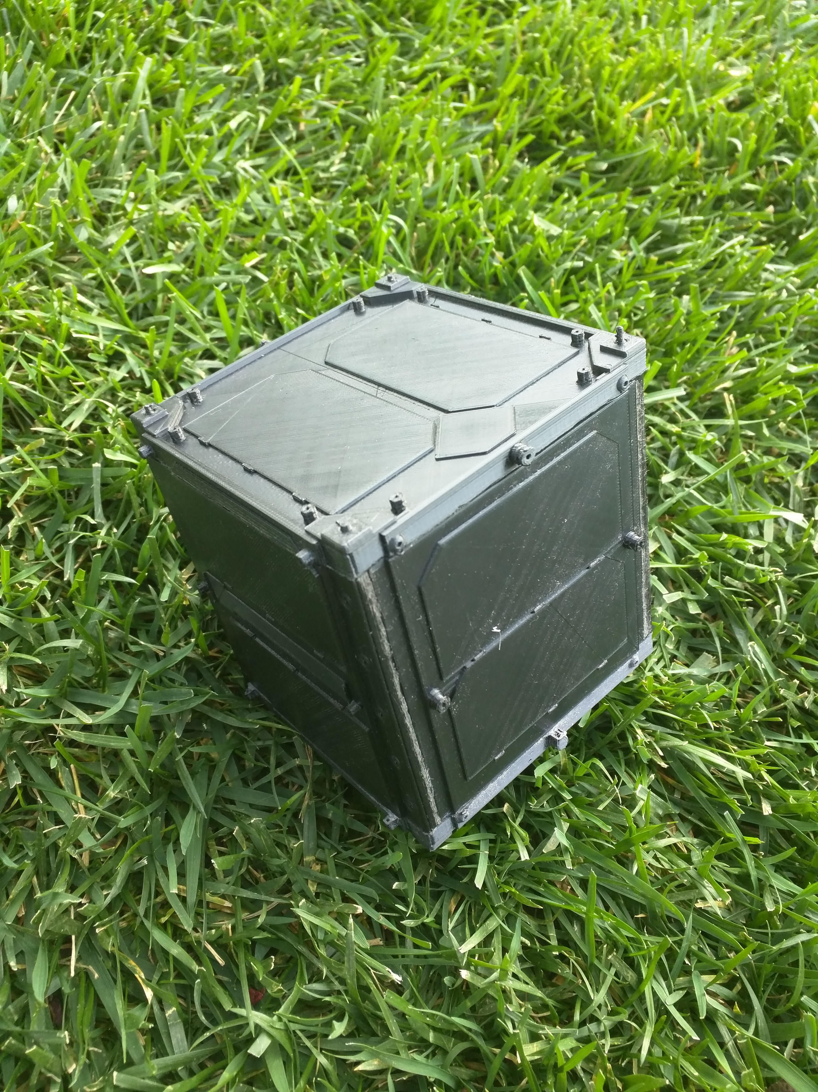
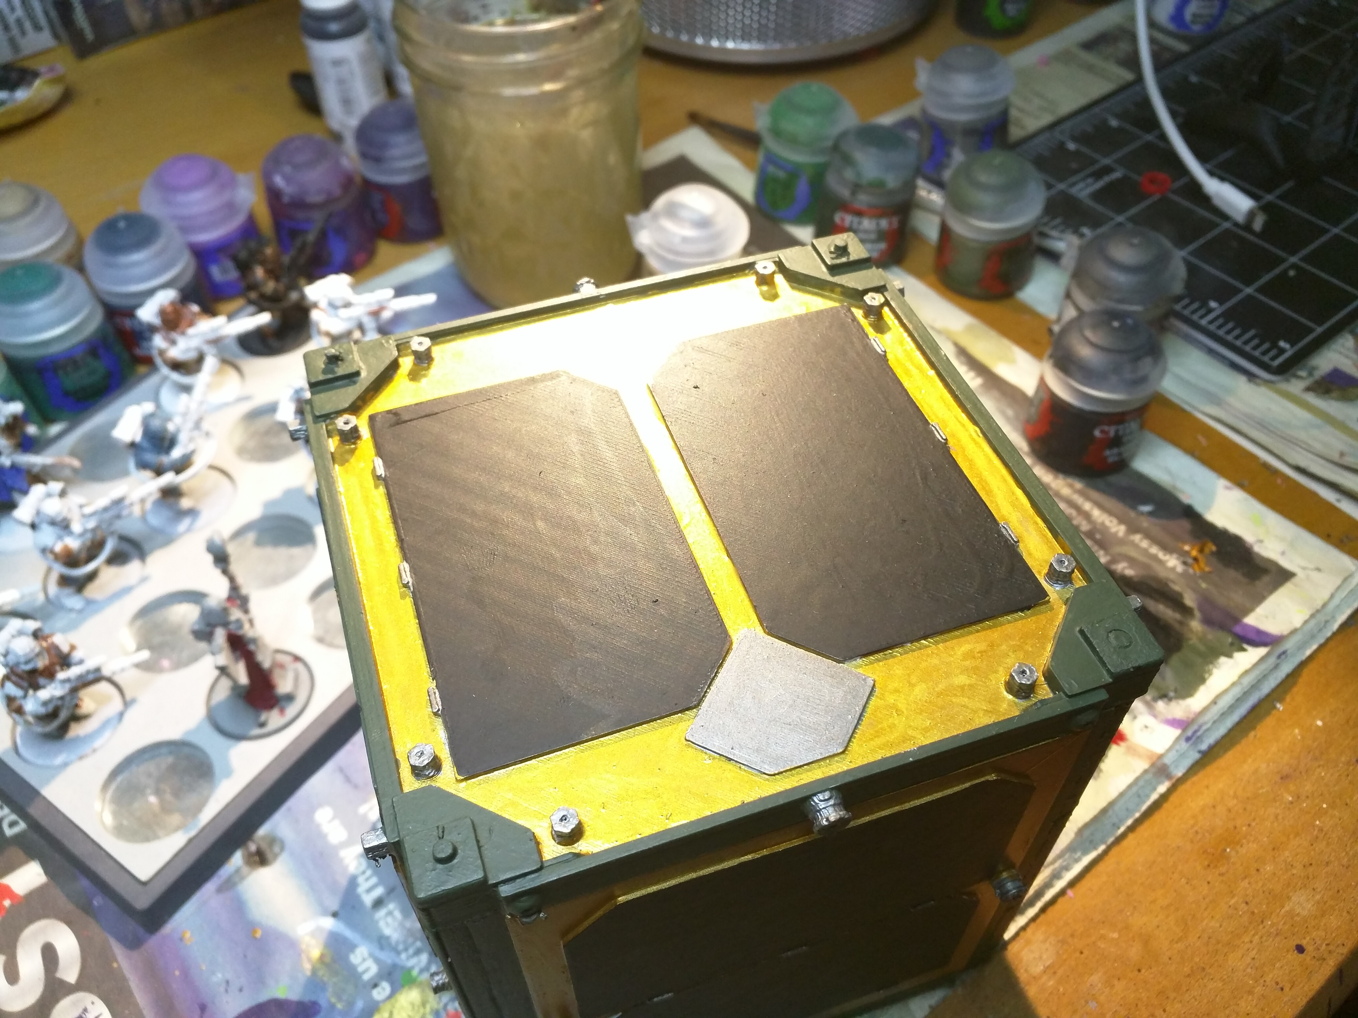
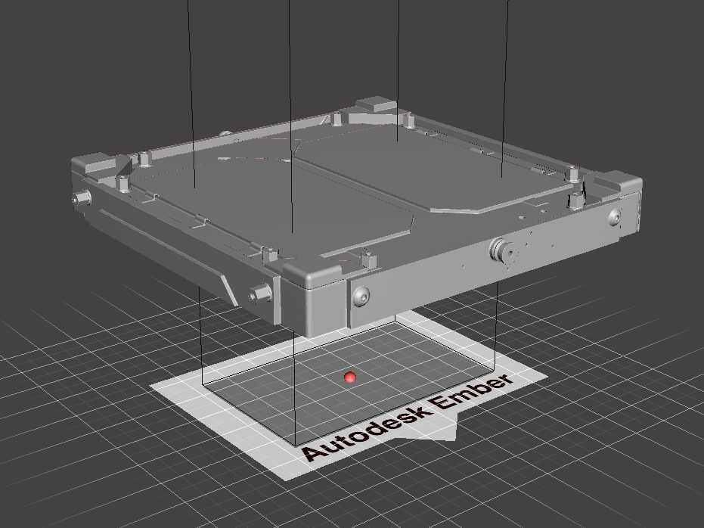
Notes:
You can find this educational 1:1 scale model of Fox 1B on Thingiverse on the web.

Slide 38
3d printed
Phase 4 Ground Dual band feed
Can we use 3d printing to make a dual band feed for phase 4 ground?

Slide 40
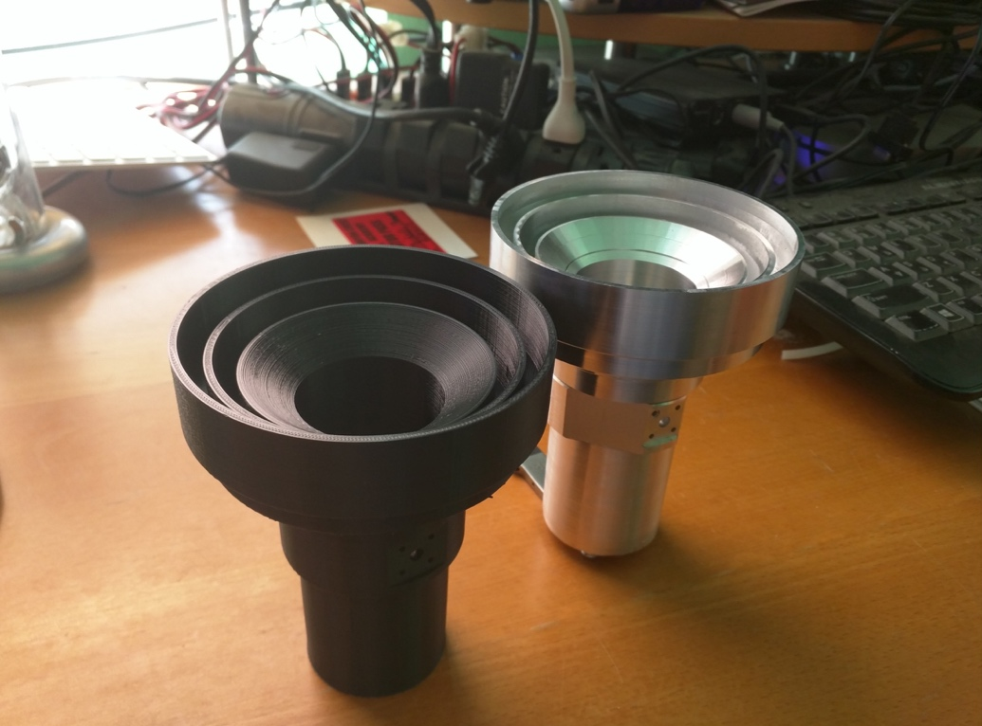

Slide 41
3d printed
122GHz system
Can we use 3d printing to make a dish, feed, and subreflector?

Slide 42
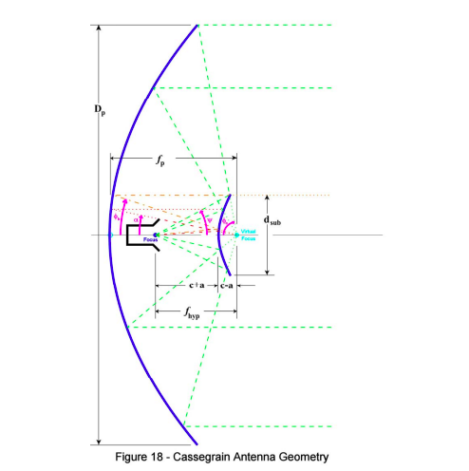

Slide 43
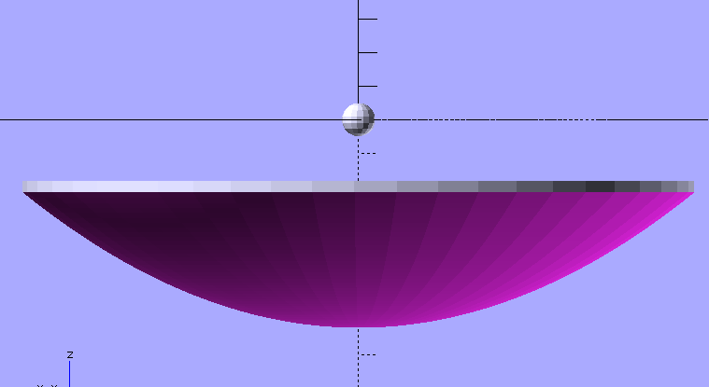

Slide 44
Status!
122GHz paper in 2017 MUD proceedings
10GHz horn paper in 2015 MUD proceedings and QEX
3D printed Fox1B model article coming up.
Dual band feed for Phase 4 Ground successfully printed, shown at AMSAT Symposium.
Metallization works very well! Connectors are the weak link.
3d printing is a great way to design antennas and models in amateur radio.

Slide 45
Thank you!
Questions?

